Slide 1


Good Practices For Azure DevOps
© 2022 Elysium Digital | Deliver better, together.

Slide 2
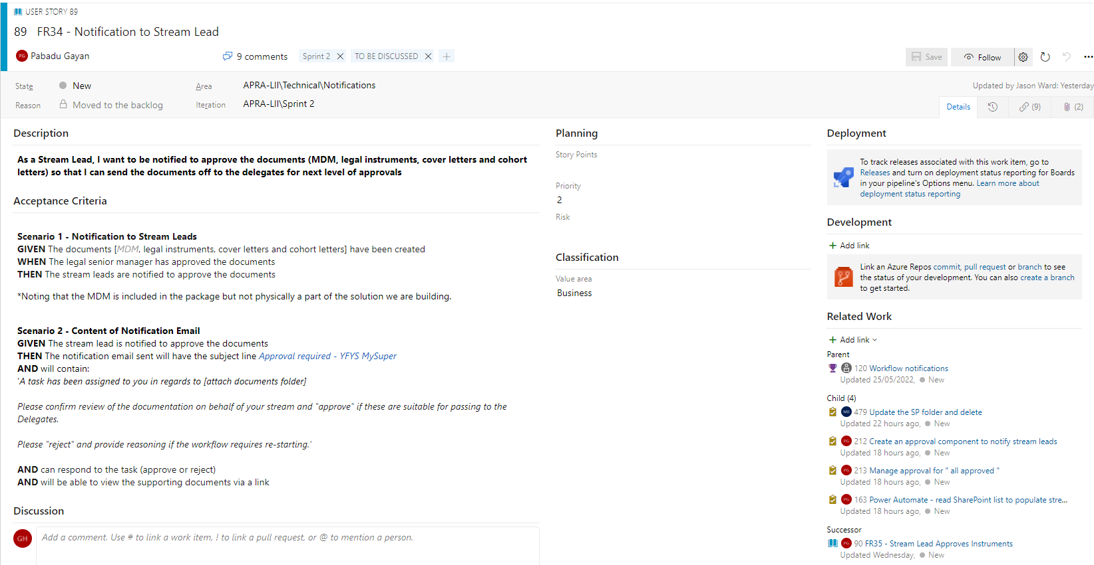
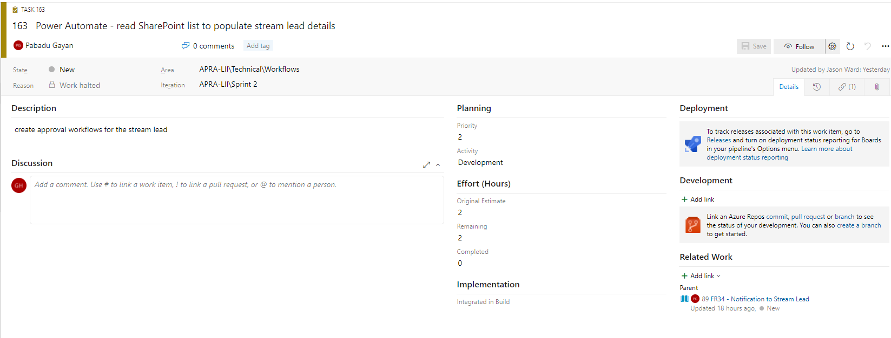
Tasks Build Stories
Every User Story should have one or more linked (child) Tasks. Tasks describe the work done to implement the User Story

Slide 3
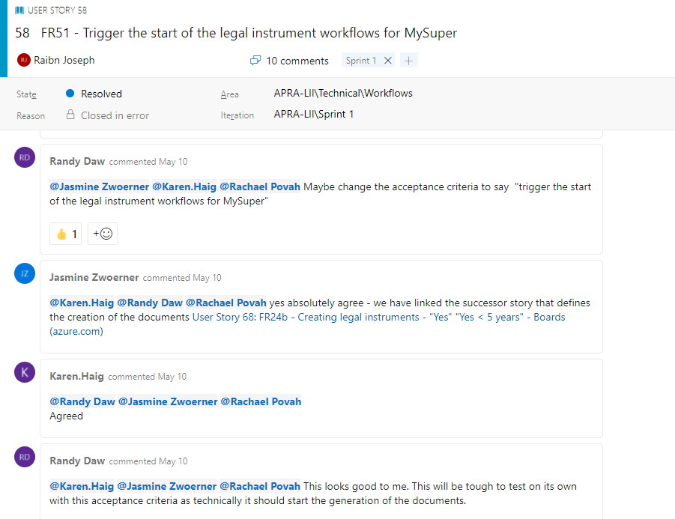
Let’s Talk
The Discussion area on work items should be used extensively.
A good comment on a Task might look like “Created new field called Potatoes (type = int) in the Vegetables table”.
A bad comment might be “Done”
Use @ mentions to alert others.

Slide 4
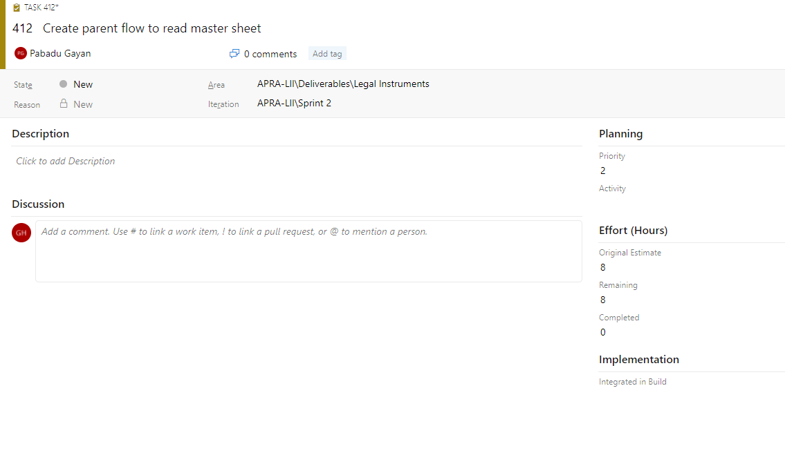
How Long?
All Tasks should be estimated in hours prior to start of sprint
Original Estimate, Remaining & Completed

Slide 5
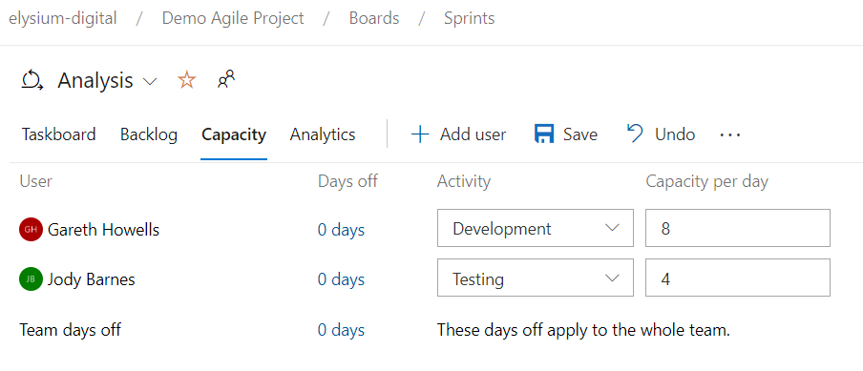
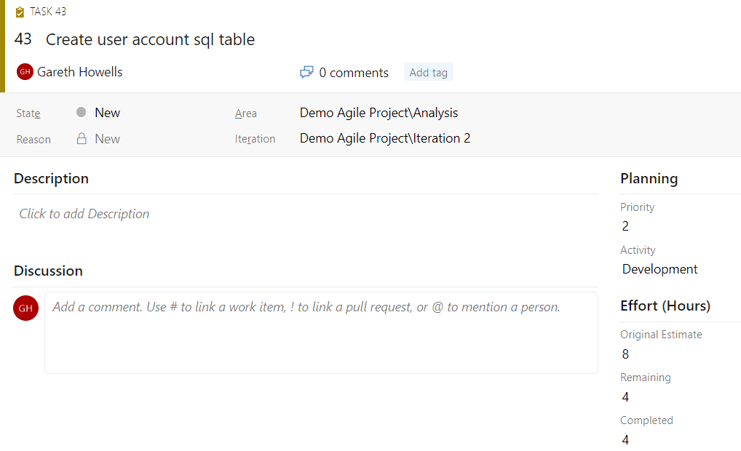
Activity & Capacity
Set the Activity & Capacity per day for each sprint team member in the Sprints / Capacity screen. This allows us to track who will do each activity (type of work) and how much effort they can expend each day of the sprint.
In the sprint Tasks set the Activity. This allows us to track how much effort needs to be applied to each activity (type of work) to complete the sprint.

Slide 6
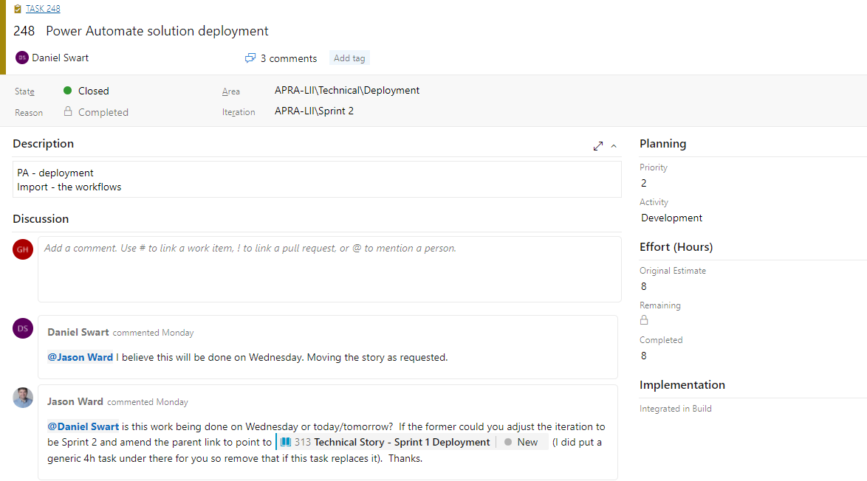
Keep Updated
When working on a Task the work done should be recorded in the Discussion area and the estimates (Completed / Remaining) updated regularly

Slide 7
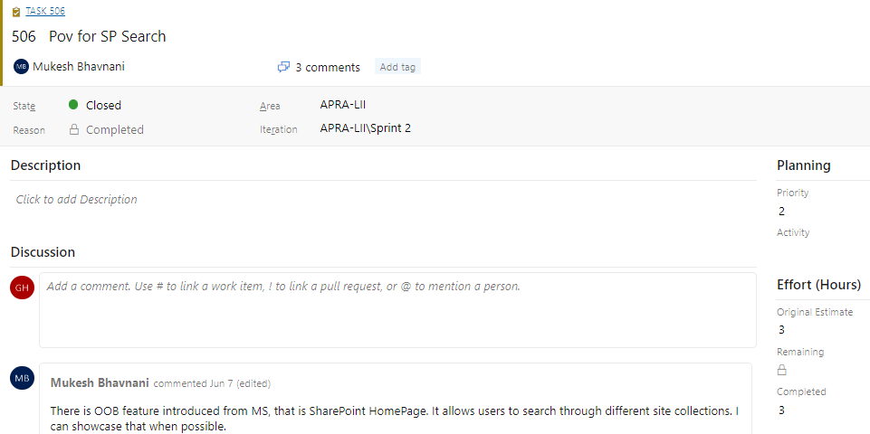
What have you done?
Think of Tasks as a (very) short form as-built document. The discussion comments should capture what was done to deliver the task.
If you created a flow say “Create flow” and drop a link to the flow. If you committed code then say “Committed code” and drop a link to the commit.
This should be done before the task is Resolved.

Slide 8
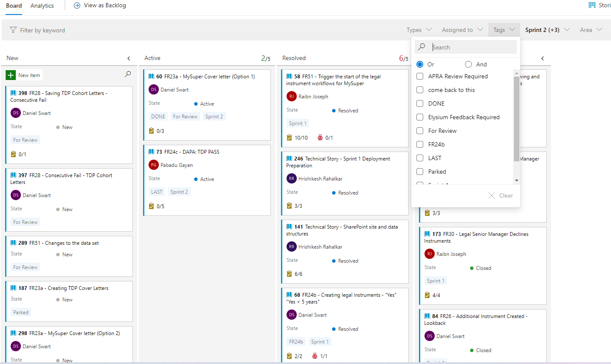
Tag – You’re It
Use Tags to group work items together

Slide 9
Comments
Try to update the “Active” Tasks assigned to you every day, even if it’s just saying
“Planning to do this next Thursday”.

Slide 10







Thank you.
Offices in
Canberra
Sydney
Brisbane
Dedicated
Designers
Developers
Strategists
A true partner.
Elysium Digital | Deliver better, together.

